Slide 1



TDD Workshop

Slide 2
How do you test your applications now?

Slide 3
Manual Testing
Slow & Time consuming
Painful
Inconsistent / not necessarily repeatable
Spend hours in the debugger

Slide 4
Automated Testing
2 advantages to TDD over manual testing
Creates an suite of automated tests
Changes your approach, so that you write better code

Slide 5
Test Suite
Fast Feedback
Repeatable
Free’s up time to focus on other things
Living documentation of your system
Warm fuzzy feeling

Slide 6
Test Driven Code
Requires change in mind-set
Don’t attempt to implement everything all at once – Focus on small problems one at a time
Red – Green - Refactor

Slide 7
tDd, not TDD!
Same words, but the emphasis is where it belongs:
Development driven from tests

Slide 8
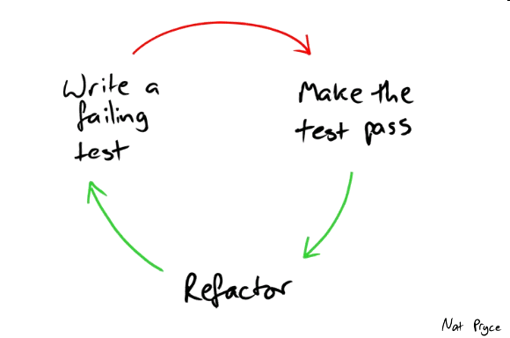



Your New Mantra

Slide 9
More specific

Slide 10
More specific

Slide 11
More specific
Clean Up, Refine, Improve

Slide 12
Hands On
Build a loan calculator for a new Payday Loan company:
Pay Dave Loans

Slide 13
Requirements
Given the requested Loan Amount (Principle) & borrow period (Term),
Using my Annual Rate (9.4%),
Calculate Monthly Repayments & Total Amount Repayable

Slide 14
Design
Quickly map out on a piece of paper the various parts of the system you are about to build, and show how these parts will interact
5 mins

Slide 15
Design
Now throw that away and forget it.
You are doing it wrong
Remember: tDd

Slide 16
Step 1.
Work out what you are trying to achieve.
This should be the simplest piece of functionality.

Slide 17
Step 2.
Write a test.
Remember the Mantra:
Red – Green - Refactor

Slide 18
Questions

Slide 19
What Next?
The Test Triangle – We have focused on unit test
Let’s Play: http://www.jamesshore.com/Blog/Lets-Play/

Slide 20
Follow Us
Richard Rodriguez
Dave Cook
http://tech.comparethemarket.com/author/richard-rodriguez/
http://tech.comparethemarket.com/author/dave-cook/
@AyahuascaCrmny
@dcookie_1981
@thectmers

